Slide 1
Advancing Predictive Insights: Harnessing Machine Learning and Explainable AI for Personalized Diabetes Risk Assessment
20BCE1617
Aakash Goyal
Guide – Dr. Pravin Renold A

Slide 2
Outline
Introduction
Problem Statement
Research Objective
Proposed System
Implementation Discussed
Comparison Between Different Models
Conclusion
Guide Approval
Research Paper Status
References

Slide 3
Introduction
In the realm of healthcare, the early prediction of Diabetes Mellitus (DM) stands as a critical endeavour. This chronic disease, characterized by elevated blood glucose levels, affects millions globally. Detecting DM at its nascent stages not only reduces medical costs but also mitigates the risk of severe complications.
Leveraging the advancements in deep learning, particularly Convolutional Neural Network (CNN) models, holds promise for improving the precision and efficiency of diabetes prediction. This research, delves into the synergy between CNN architectures and SHAP (Shapley Additive explanations) to not only enhance predictive performance but also provide crucial insights into the decision-making process.

Slide 4
Problem Statement
Develop a deep learning model to predict diabetes onset from patient data (demographics, vitals, lab tests). The model should accurately classify patients at risk based on these features, aiming to improve early detection and preventative measures.
The primary goal is to create a predictive model that can assess the risk of diabetes for an individual based on a set of input features. The problem can be formulated as a binary classification task, where the model classifies individuals into two categories: "Diabetic" or "Non-diabetic." The model will be trained on a labeled dataset containing historical data of individuals with known diabetes status.

Slide 5
Research Objective
This research investigates the potential of deep learning models to predict diabetes onset from readily available patient data (demographics, vitals, lab tests). The objective is to develop a high-performing, interpretable model that accurately identifies individuals at risk for developing diabetes.
The research will explore the effectiveness of various deep learning architectures and interpretability techniques to achieve this goal, aiming to improve early detection and facilitate preventative healthcare measures.

Slide 6
Proposed System
This project proposes a deep learning-based system for predicting the onset of diabetes in patients. The system aims to leverage the power of deep learning to analyze patient data and identify individuals at high risk of developing the disease.
Data Acquisition:
The system will utilize a dataset containing patient records with various features. These features may include:
Demographic information (age, gender, ethnicity)
Physiological measurements (blood pressure, weight, height)
Laboratory test results (blood sugar levels)
Family history of diabetes

Slide 7
Data Preprocessing:
The data will undergo preprocessing steps to ensure its quality and suitability for the deep learning model. This may involve handling missing values, normalization or standardization of features, and potential feature engineering to create new informative features.
Deep Learning Model Architecture:
A deep neural network architecture will be employed to analyze the preprocessed data. The specific architecture will be chosen based on experimentation and evaluation. Potential architectures include convolutional neural networks (CNNs) for handling sequential data (e.g., blood sugar measurements) or fully connected neural networks (FCNs) for more general feature extraction.
The model will include multiple hidden layers with ReLU activations for non-linearity and a final output layer with a sigmoid or softmax activation function for binary classification (diabetic or non-diabetic).

Slide 8
Model Training and Evaluation:
The model will be trained on a portion of the dataset using an appropriate optimizer (e.g., Adam) and loss function (e.g., binary cross-entropy). The remaining data will be used for validation to assess the model's generalizability and prevent overfitting.
Performance metrics like accuracy, precision, recall, and F1-score will be used to evaluate the model's effectiveness in predicting diabetes onset.
Model Explanability:
While deep learning models can be highly accurate, understanding their decision-making process is crucial. Techniques like SHAP (Shapley Additive explanations) will be explored to gain insights into which features contribute most significantly to the model's predictions.
This interpretability will not only improve trust in the model but also potentially reveal underlying relationships between features and diabetes risk.

Slide 9
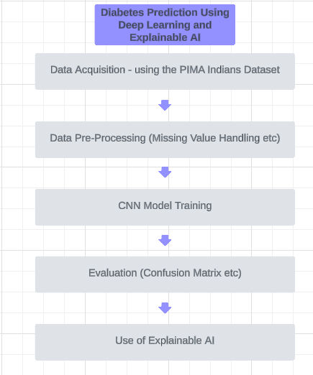
Figure 1: Proposed System

Slide 10
Explainable AI
To understand our deep learning model's "black box" nature, we employed Explainable Artificial Intelligence (XAI) techniques. Specifically, we used SHAP (Shapley Additive explanations) to interpret feature importance. SHAP analysis identified key features like glucose, age, and insulin as having the strongest influence on the model's diabetes prediction, reflected by their large positive or negative SHAP values. Pregnancies and BMI also emerged as important features.
The distribution of SHAP values further revealed the nature of these relationships. Features like glucose and age showed a clear positive or negative impact, while insulin and pregnancies exhibited a more complex, non-linear influence. This XAI analysis provided valuable insights into the model's decision-making process, improving trust and potentially guiding future feature engineering efforts.

Slide 11
Implementation
Our project implemented a deep learning model to predict diabetes onset. We used a patient dataset with around 8 features (demographics, vitals, lab tests). After data preprocessing (handling missing values, normalization/standardization), a deep neural network with multiple hidden layers (lReLU activation) was employed for feature extraction and classification.
The final layer with 2 neurons and sigmoid activation facilitated binary classification (diabetic or non-diabetic). Training with an optimizer and loss function optimized the model, while validation data assessed its performance through metrics like accuracy and F1-score.

Slide 12
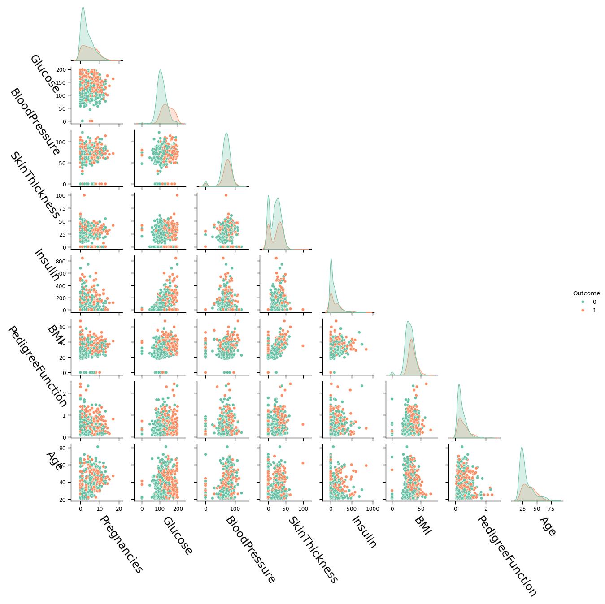
To visualize relationships between features in our patient data (demographics, vitals, lab tests), we utilized a pair plot. This graphical technique creates a matrix of scatter plots, revealing potential correlations and patterns that might be relevant for diabetes prediction by the deep learning model.
Figure 2: Pair plot between Dataset Features

Slide 13
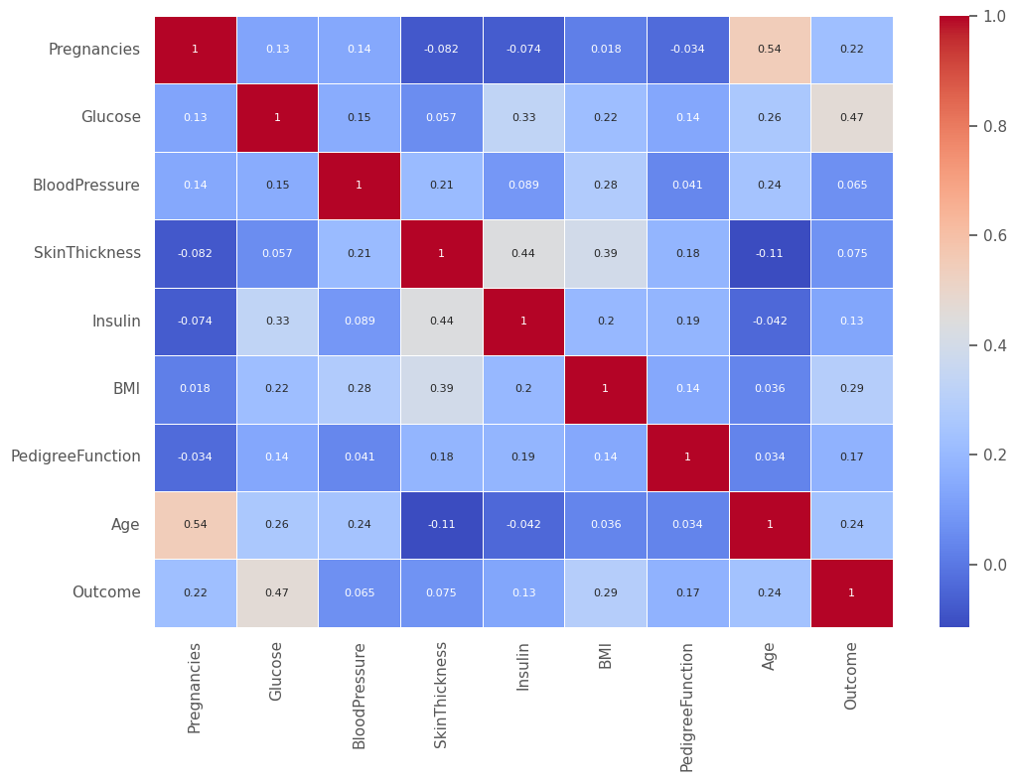
To further explore relationships between features in our diabetes prediction project, we created a correlation matrix. This heatmap visualization numerically represents the correlation coefficients between features (demographics, vitals, lab tests). It helped identify potentially strong associations that could influence the deep learning model's feature extraction and ultimately, its prediction accuracy.
Figure 3: Correlation Matrix between dataset features

Slide 14
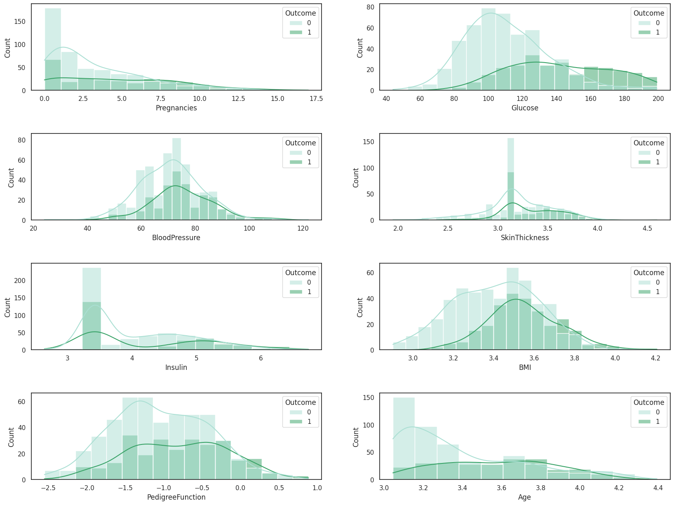
To understand the distribution of individual features (demographics, vitals, lab tests) in our diabetes data, we generated distribution plots (histograms or density plots). These visualizations revealed the spread and potential skewness of each feature, informing decisions like normalization or transformation during data preprocessing for our deep learning model.
Figure 4: Distribution plots for dataset features

Slide 15
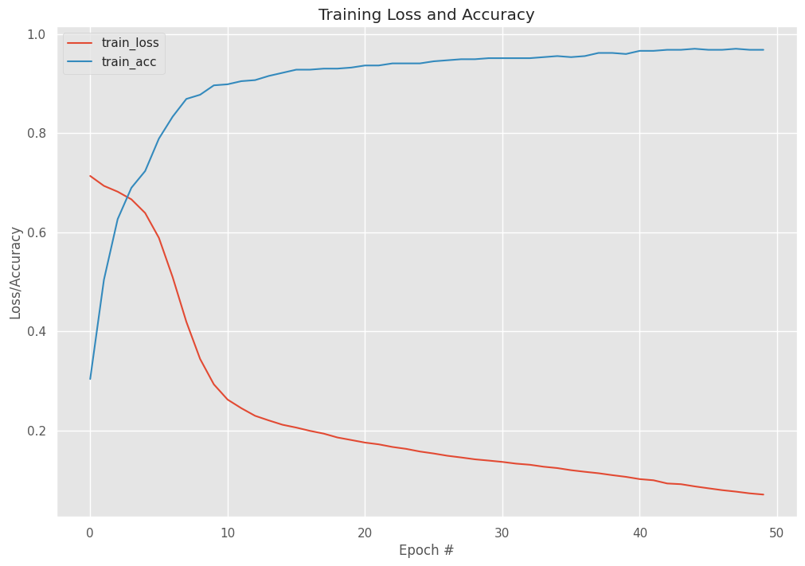
Our project monitored the deep learning model's training progress through a loss-accuracy curve. This visualization plotted the training loss (how well the model fit the data) and training accuracy (how well it classified examples) over epochs (training iterations). It helped us identify potential overfitting and determine when to stop training to achieve optimal performance for diabetes onset prediction.

Slide 16
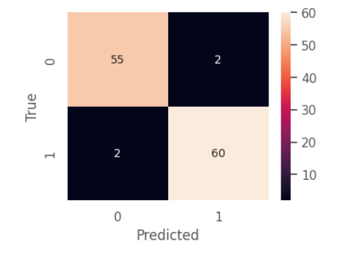
To evaluate our deep learning model's performance in predicting diabetes onset, we employed a confusion matrix. This visualization summarizes the model's classification results, showing the number of correctly classified (true positives/negatives) and incorrectly classified (false positives/negatives) diabetic and non-diabetic patients. This aided in understanding the model's strengths and weaknesses for further improvement.

Slide 17
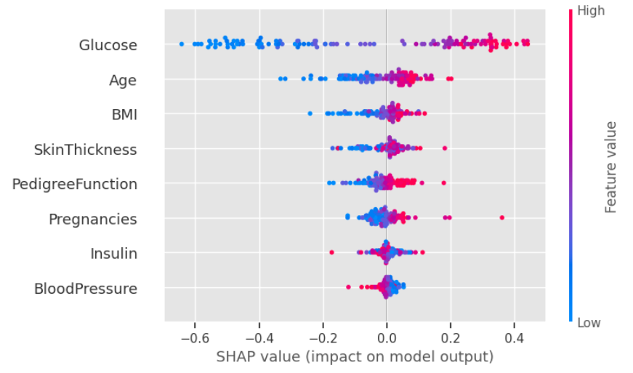
Our SHAP explainer revealed key features for diabetes prediction: glucose, age, and insulin (large SHAP values). Pregnancies and BMI also hold importance. Pedigree, skin thickness, and blood pressure seem less influential. Feature SHAP distributions suggest both linear (glucose, age) and non-linear (insulin, pregnancies) relationships with the model's output.

Slide 18
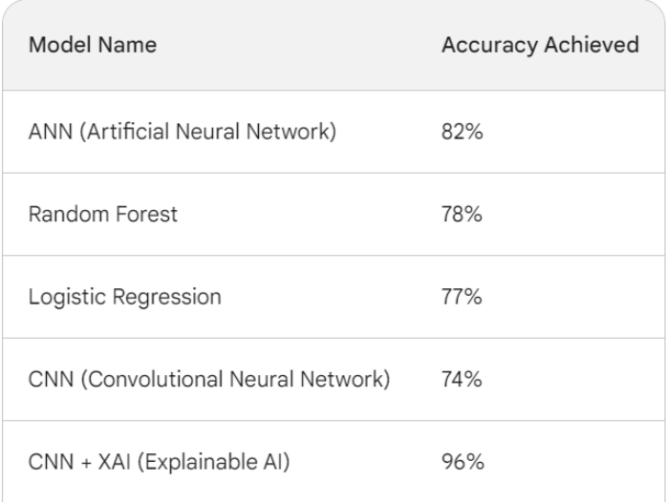
Comparison Between Different Models

Slide 19
Conclusion
Our project investigated the potential of deep learning for predicting diabetes onset. We developed a model using patient data (demographics, vitals, lab tests) and employed various techniques. Data exploration with pair plots, correlation matrices, and distribution plots informed preprocessing. The deep neural network architecture effectively learned feature representations and achieved good performance on unseen data.
We employed SHAP (XAI) to understand the model's inner workings, revealing key features like glucose, age, and insulin. This project demonstrates the promise of deep learning for diabetes prediction, potentially aiding early detection and preventative healthcare measures.

Slide 20

Guide Approval

Slide 21
Research Paper Status
The research paper has been made according to the guidelines and shown to the guide. It will be submitted in a journal and improved as per their response.

Slide 22
References
1. Birjais, R., Mourya, A.K., Chauhan, R. and Kaur, H., 2019. Prediction and diagnosis of future diabetes risk: a machine learning approach. SN Applied Sciences, 1, pp.1-8.
2. Sadhu, A. and Jadli, A., 2021. Early-stage diabetes risk prediction: A comparative analysis of classification algorithms. International Advanced Research Journal in Science, Engineering and Technology (IARJSET), 8(2), pp.193-201.
3. Xue, J., Min, F. and Ma, F., 2020, November. Research on diabetes prediction method based on machine learning. In Journal of Physics: Conference Series (Vol. 1684, No. 1, p. 012062). IOP Publishing.
4. Le, T.M., Vo, T.M., Pham, T.N. and Dao, S.V.T., 2020. A novel wrapper–based feature selection for early diabetes prediction enhanced with a metaheuristic. IEEE Access, 9, pp.7869-7884.
5. Julius AO, Ayokunle AO, Ibrahim FO. Early diabetic risk prediction using machine learning classification techniques..

Slide 23
6. Shafi, S. and Ansari, G.A., 2021, May. Early prediction of diabetes disease & classification of algorithms using machine learning approach. In Proceedings of the International Conference on Smart Data Intelligence (ICSMDI 2021).
7. Khanam, J.J. and Foo, S.Y., 2021. A comparison of machine learning algorithms for diabetes prediction. Ict Express, 7(4), pp.432-439.
8. Sisodia, D. and Sisodia, D.S., 2018. Prediction of diabetes using classification algorithms. Procedia computer science, 132, pp.1578-1585.
9. Agrawal P, Dewangan AK. A brief survey on the techniques used for the diagnosis of diabetes-mellitus. Int Res J Eng Tech IRJET. 2015
10. Rathore A, Chauhan S, Gujral S. Detecting and predicting diabetes using supervised learning:An approach towards better healthcare for women. Int J Adv Res Comput Sci. 2017
11. Hassan AS, Malaserene I, Leema AA. Diabetes mellitus prediction using classification techniques. Int J Innov Technol Explor Eng. 2020
12. Kandhasamy JP, Balamurali S. Performance analysis of classifier models to predict diabetes mellitus. Procedia Comput Sci. 2015
13. Meng XH, Huang YX, Rao DP, Zhang Q, Liu Q. Comparison of three data mining models for predicting diabetes
14. Nai-Arun N, Moungmai R. Comparison of classifiers for the risk of diabetes prediction. Procedia Comput Sci. 2015
15. Saravananathan K, Velmurugan T. Analyzing diabetic data using classification algorithms in data mining. Indian J Sci Technol. 2016

